Slide 1
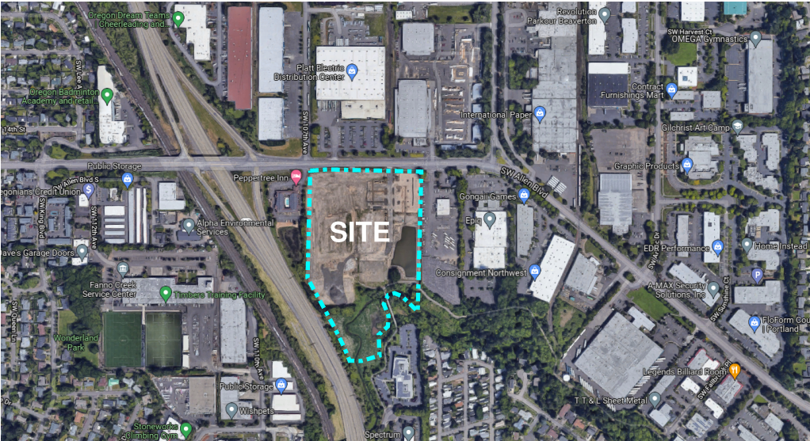
Vicinity Map

Slide 2
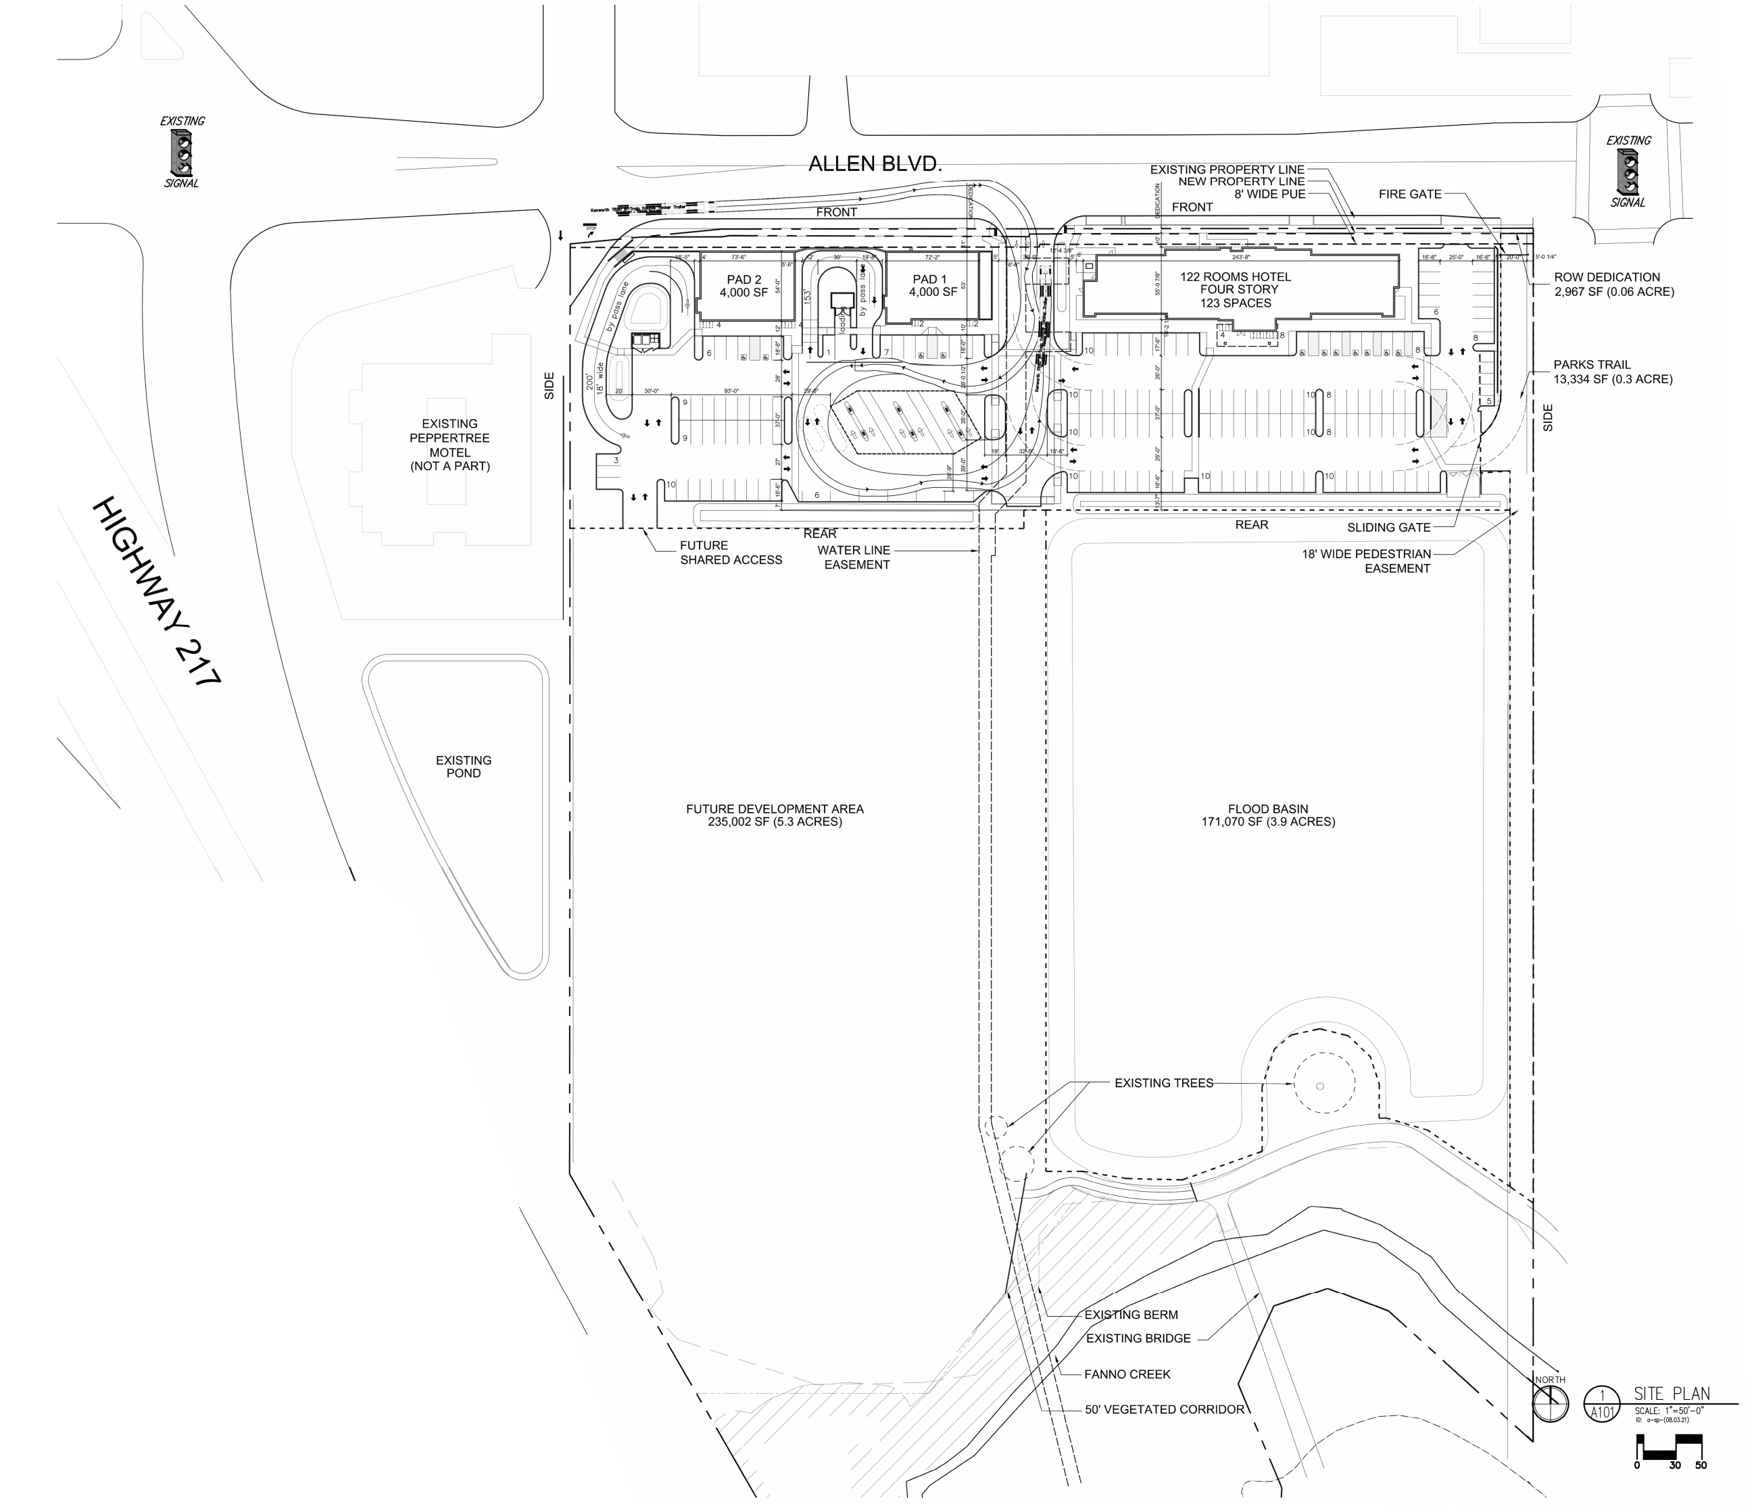
Site Plan

Slide 3
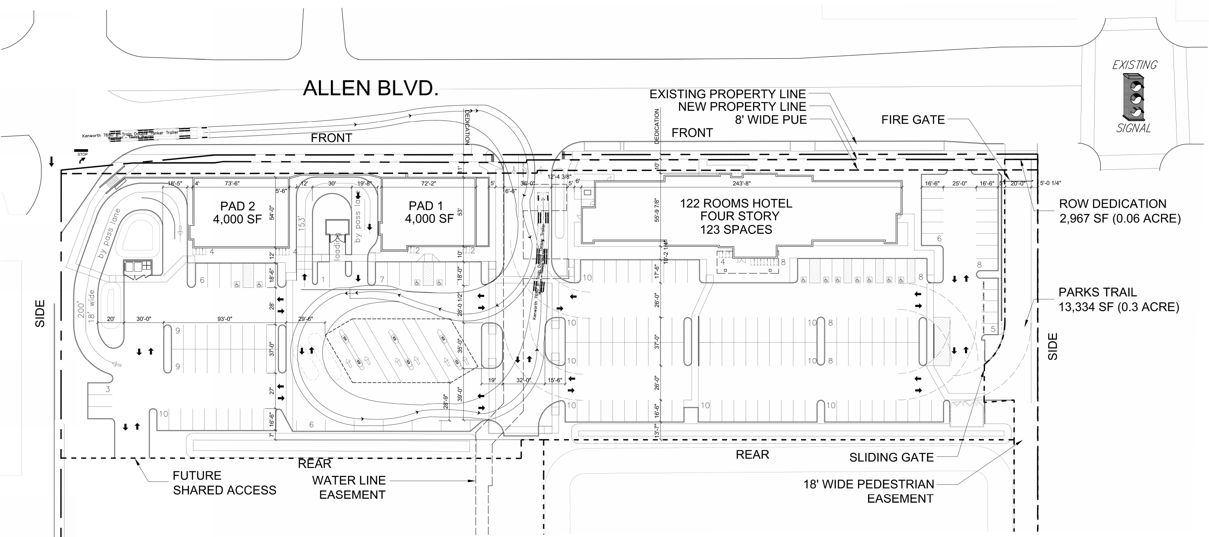
Enlarged Site Plan

Slide 4
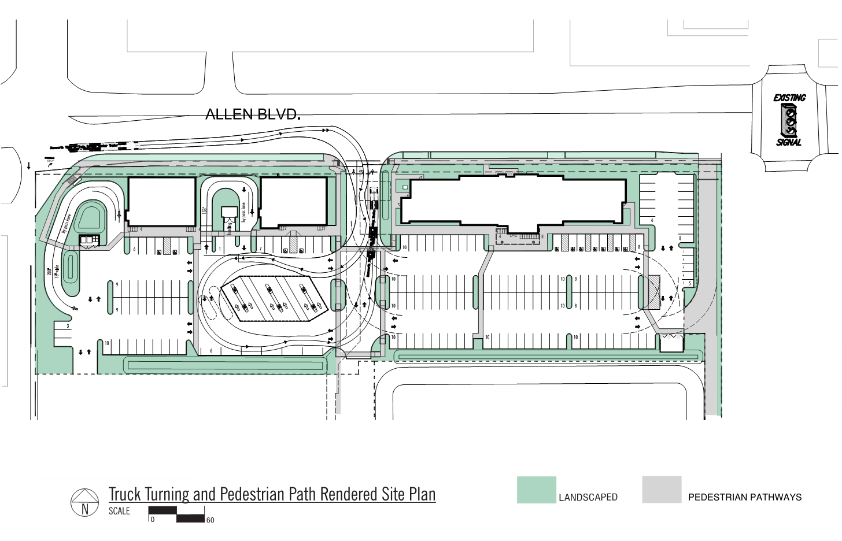
Pedestrian Pathways

Slide 5
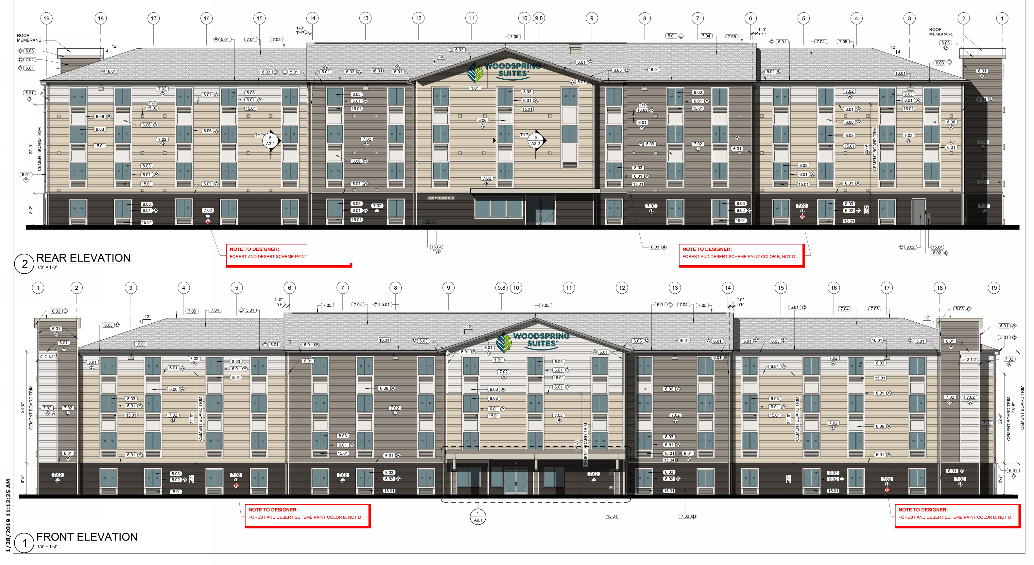
Hotel Elevations
NORTH ELEVATION
SOUTH ELEVATION

Slide 6
Hotel Elevations
WEST ELEVATION
EAST ELEVATION

Slide 7
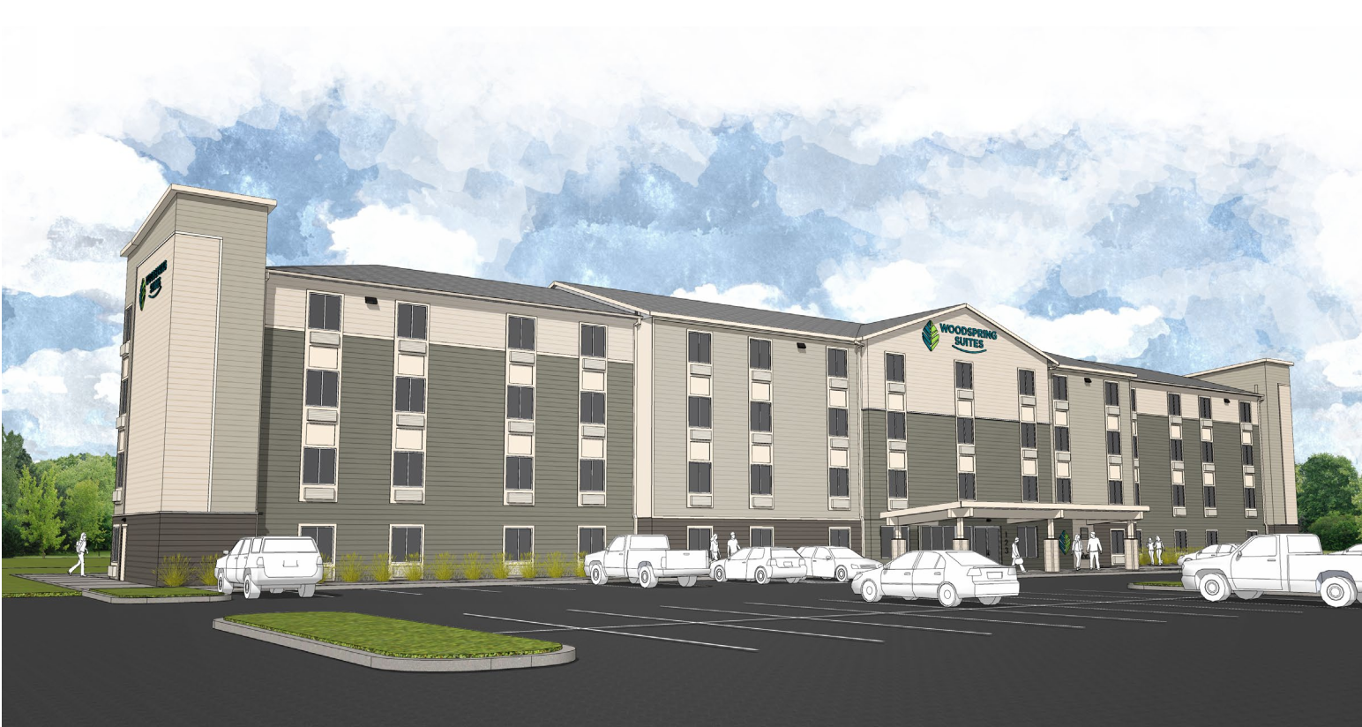
Hotel: Forest (color) Scheme

Slide 8
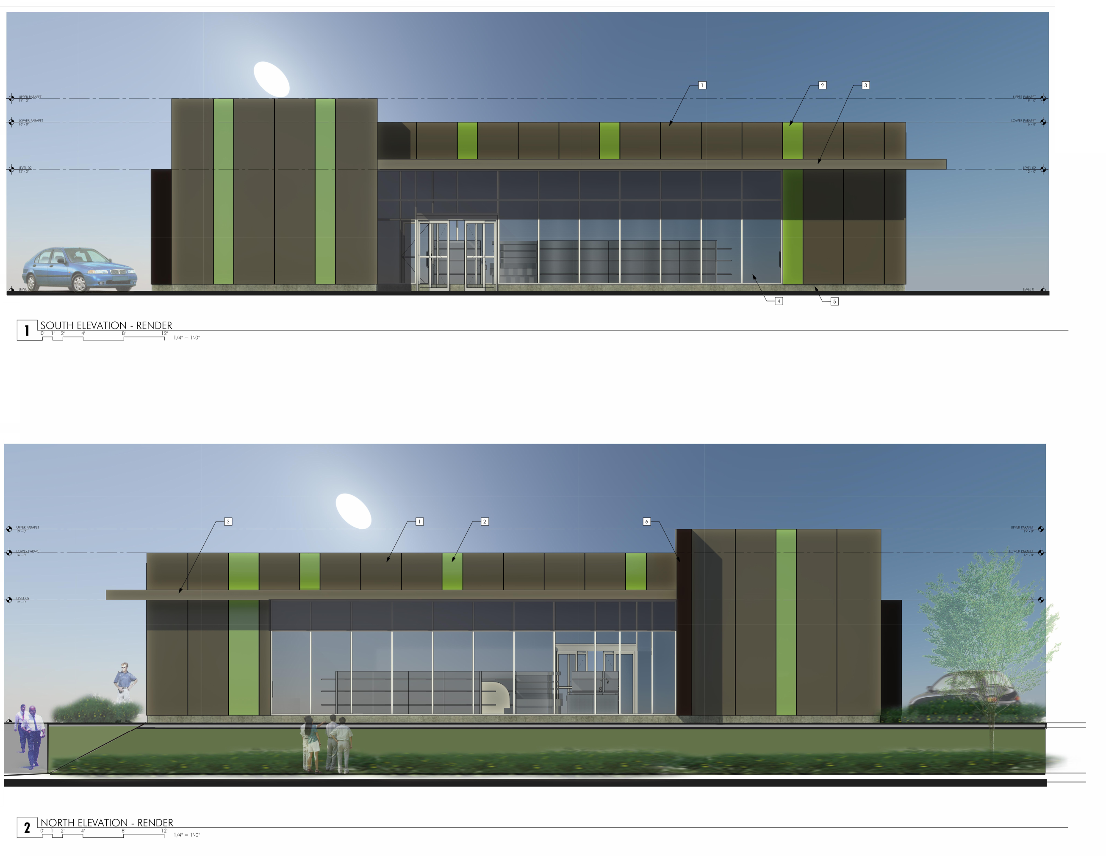
Pad 1 Elevations

Slide 9
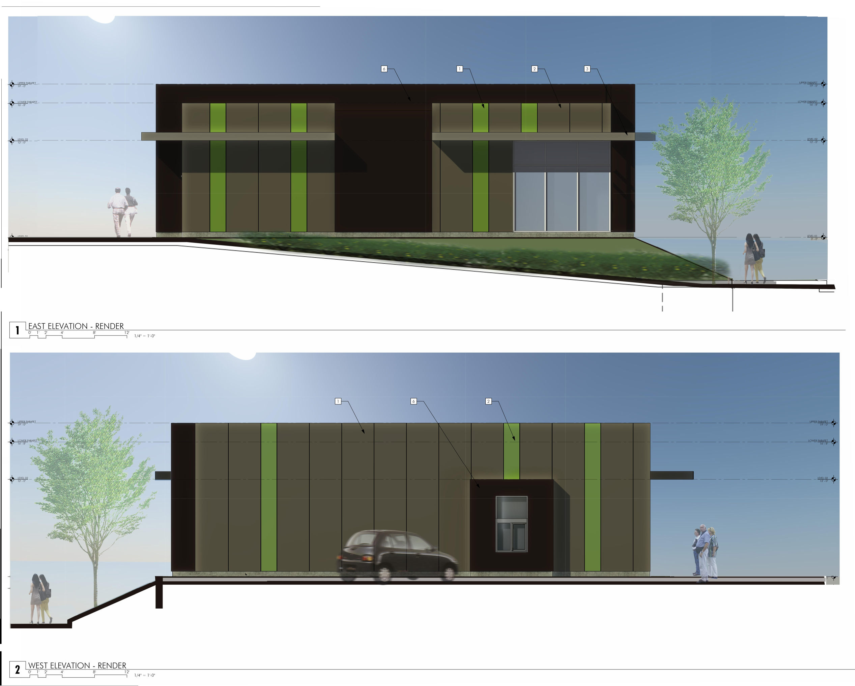
Pad 1 Elevations

Slide 10
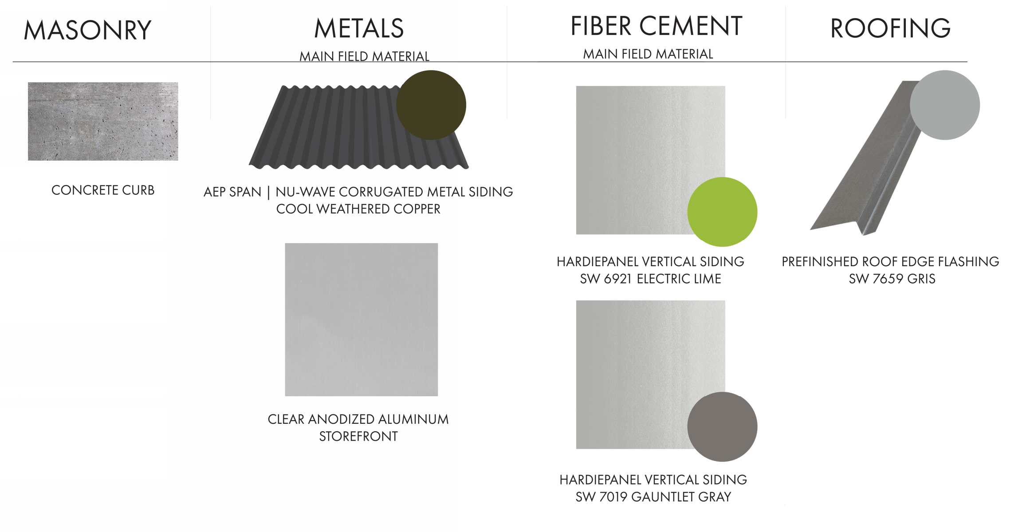
Pad 1 Materials

Slide 11
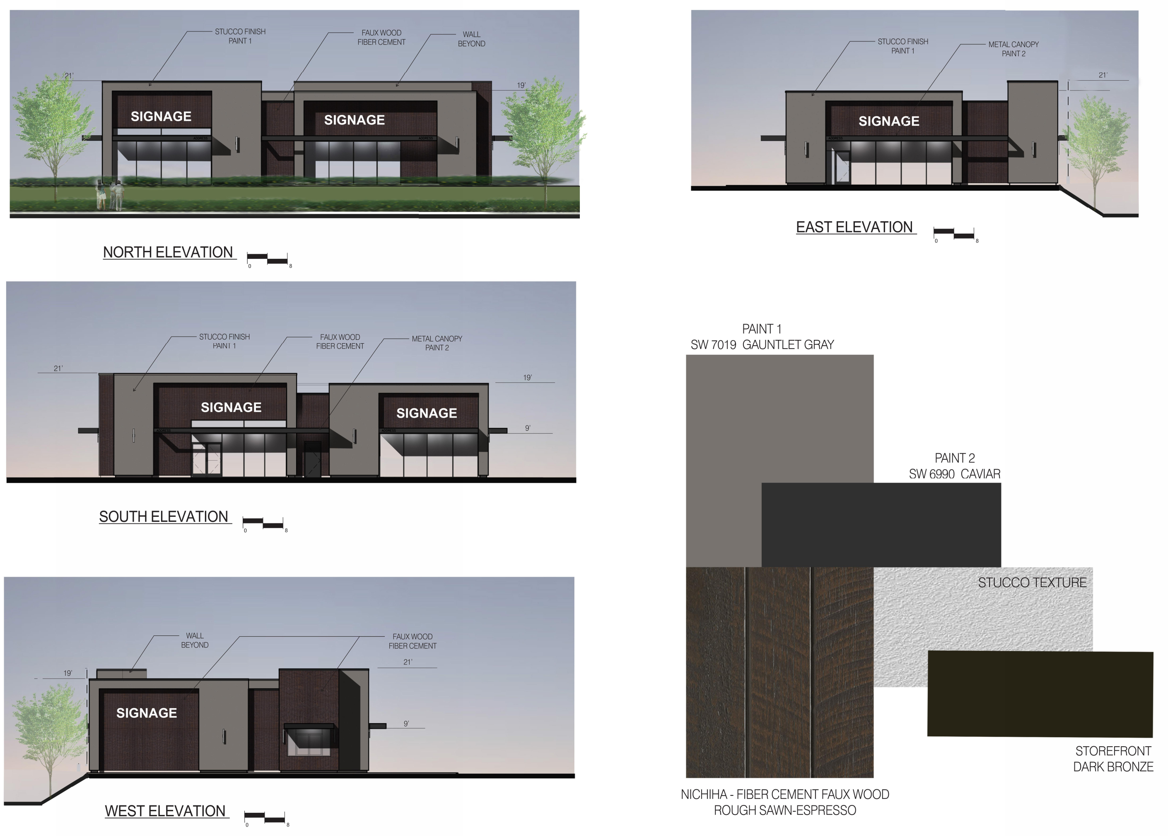
Pad 2 Elevations & Materials

Slide 12
Condition as Written:
B. Prior to issuance o the site development permit, the applicant shall:
8. Submit to the City of a copy of issued permits or other approvals needed form the Oregon Department of Transportation for work within, and/or construction access to ODOT right of way (Site Development Div. / SAS)
Requested Revision:
Move Condition B(8) to “E. Prior to final inspection/occupancy of any building permit”
As written condition 8(B) requires ODOT permits be issued before site and building permits can be issued. ODOT permitting is a long process that will delay work onsite until after the fall rains begin. This will negatively impact the project and push the construction start a full year to spring of 2023. Moving the condition to Section E will allow site and building construction to begin before fall rains and still ensure the ROW improvements are completed before occupancy.

Slide 14
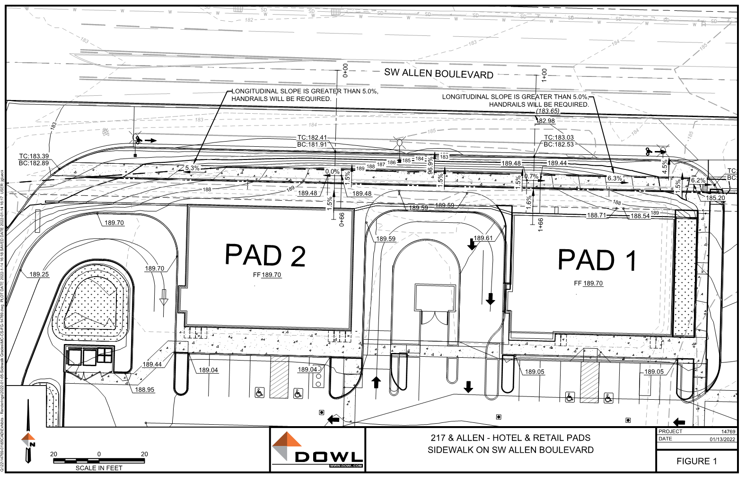
Raised ROW Sidewalk Assessment

Slide 15
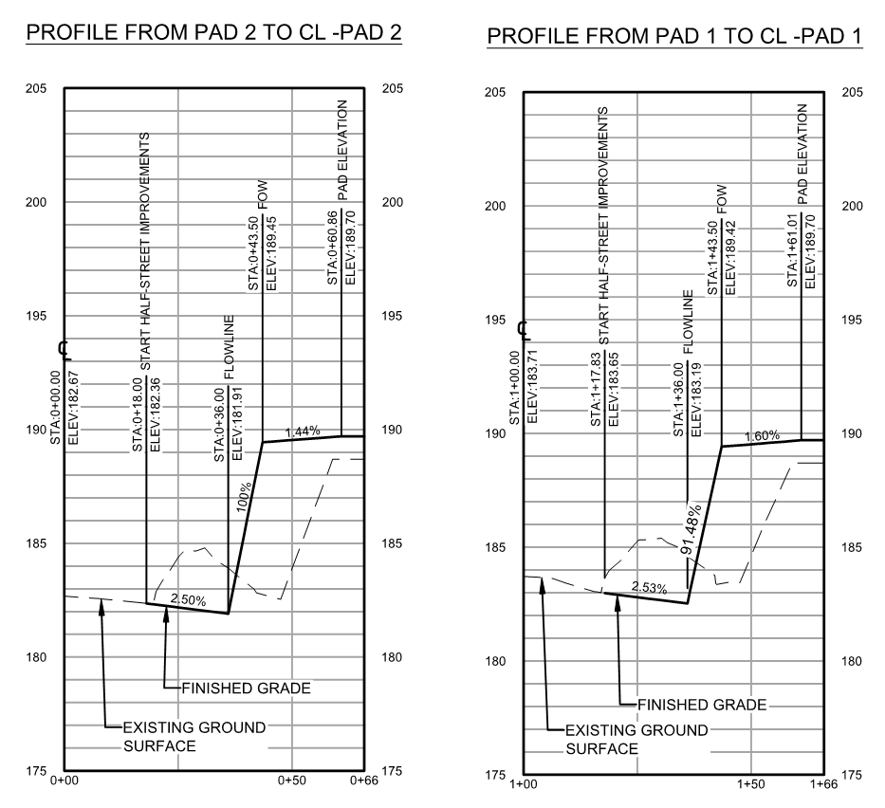
(CURB)
(CURB)
SIDEWALK
SIDEWALK
ROW
ROW

Slide 16
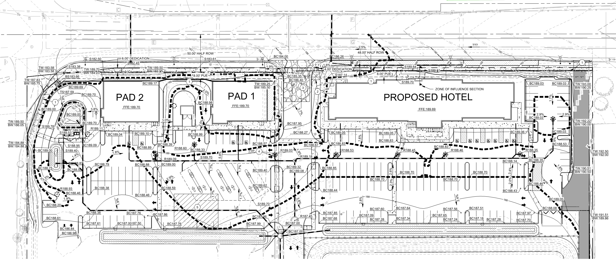
Grading Plan

Slide 17
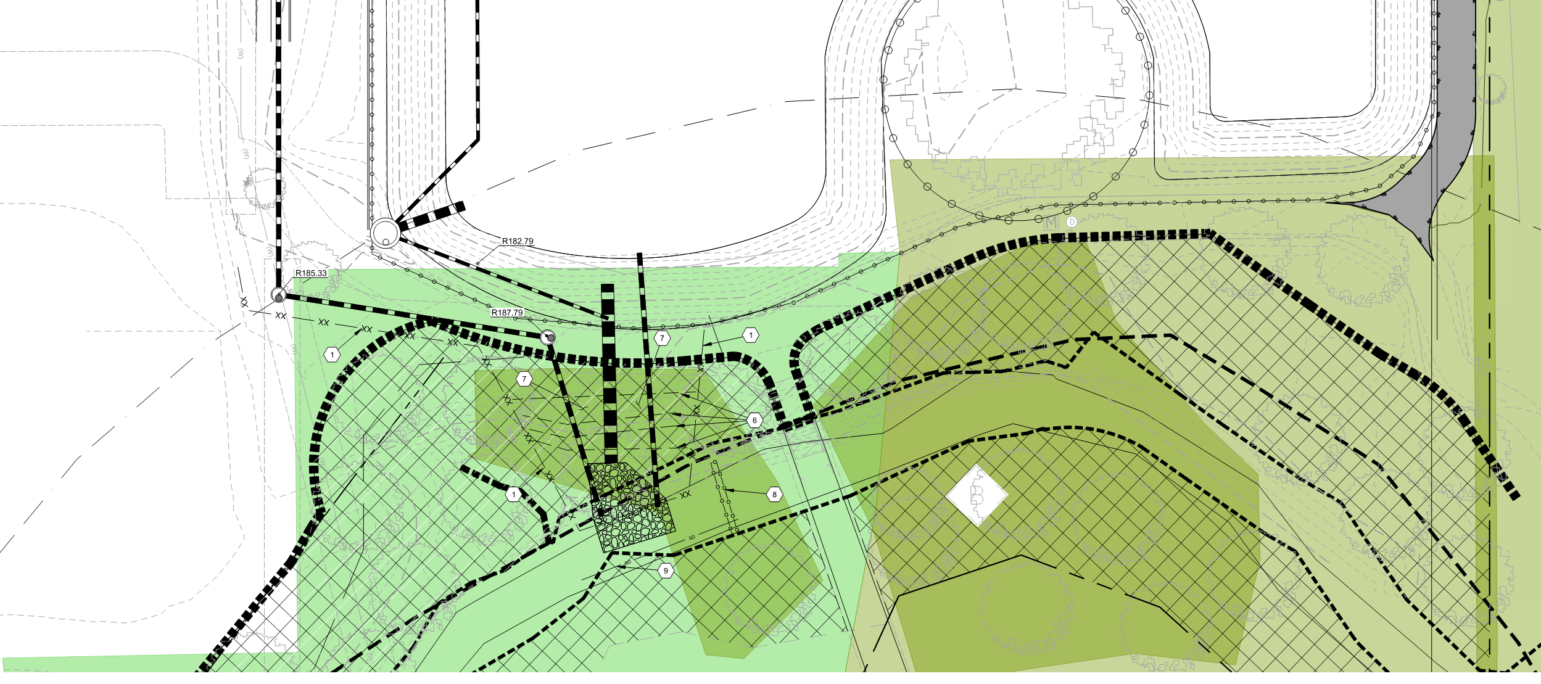
Grading Plan

Slide 18
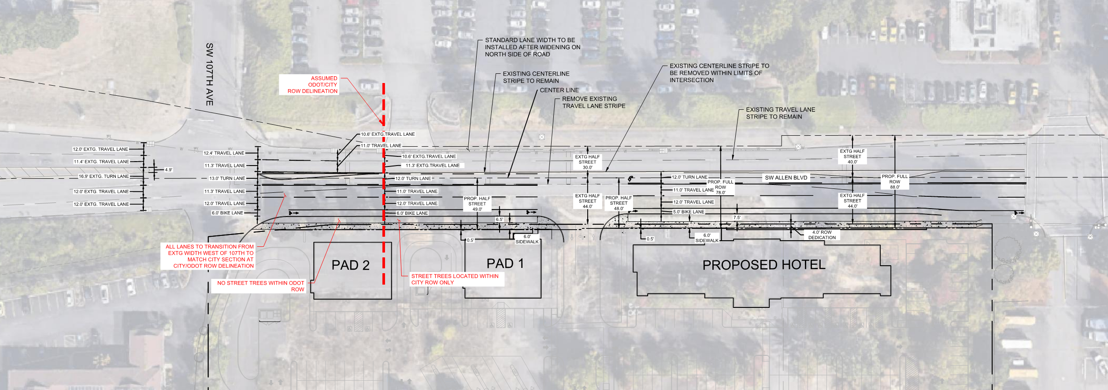
ROW Striping Exhibit

Slide 19
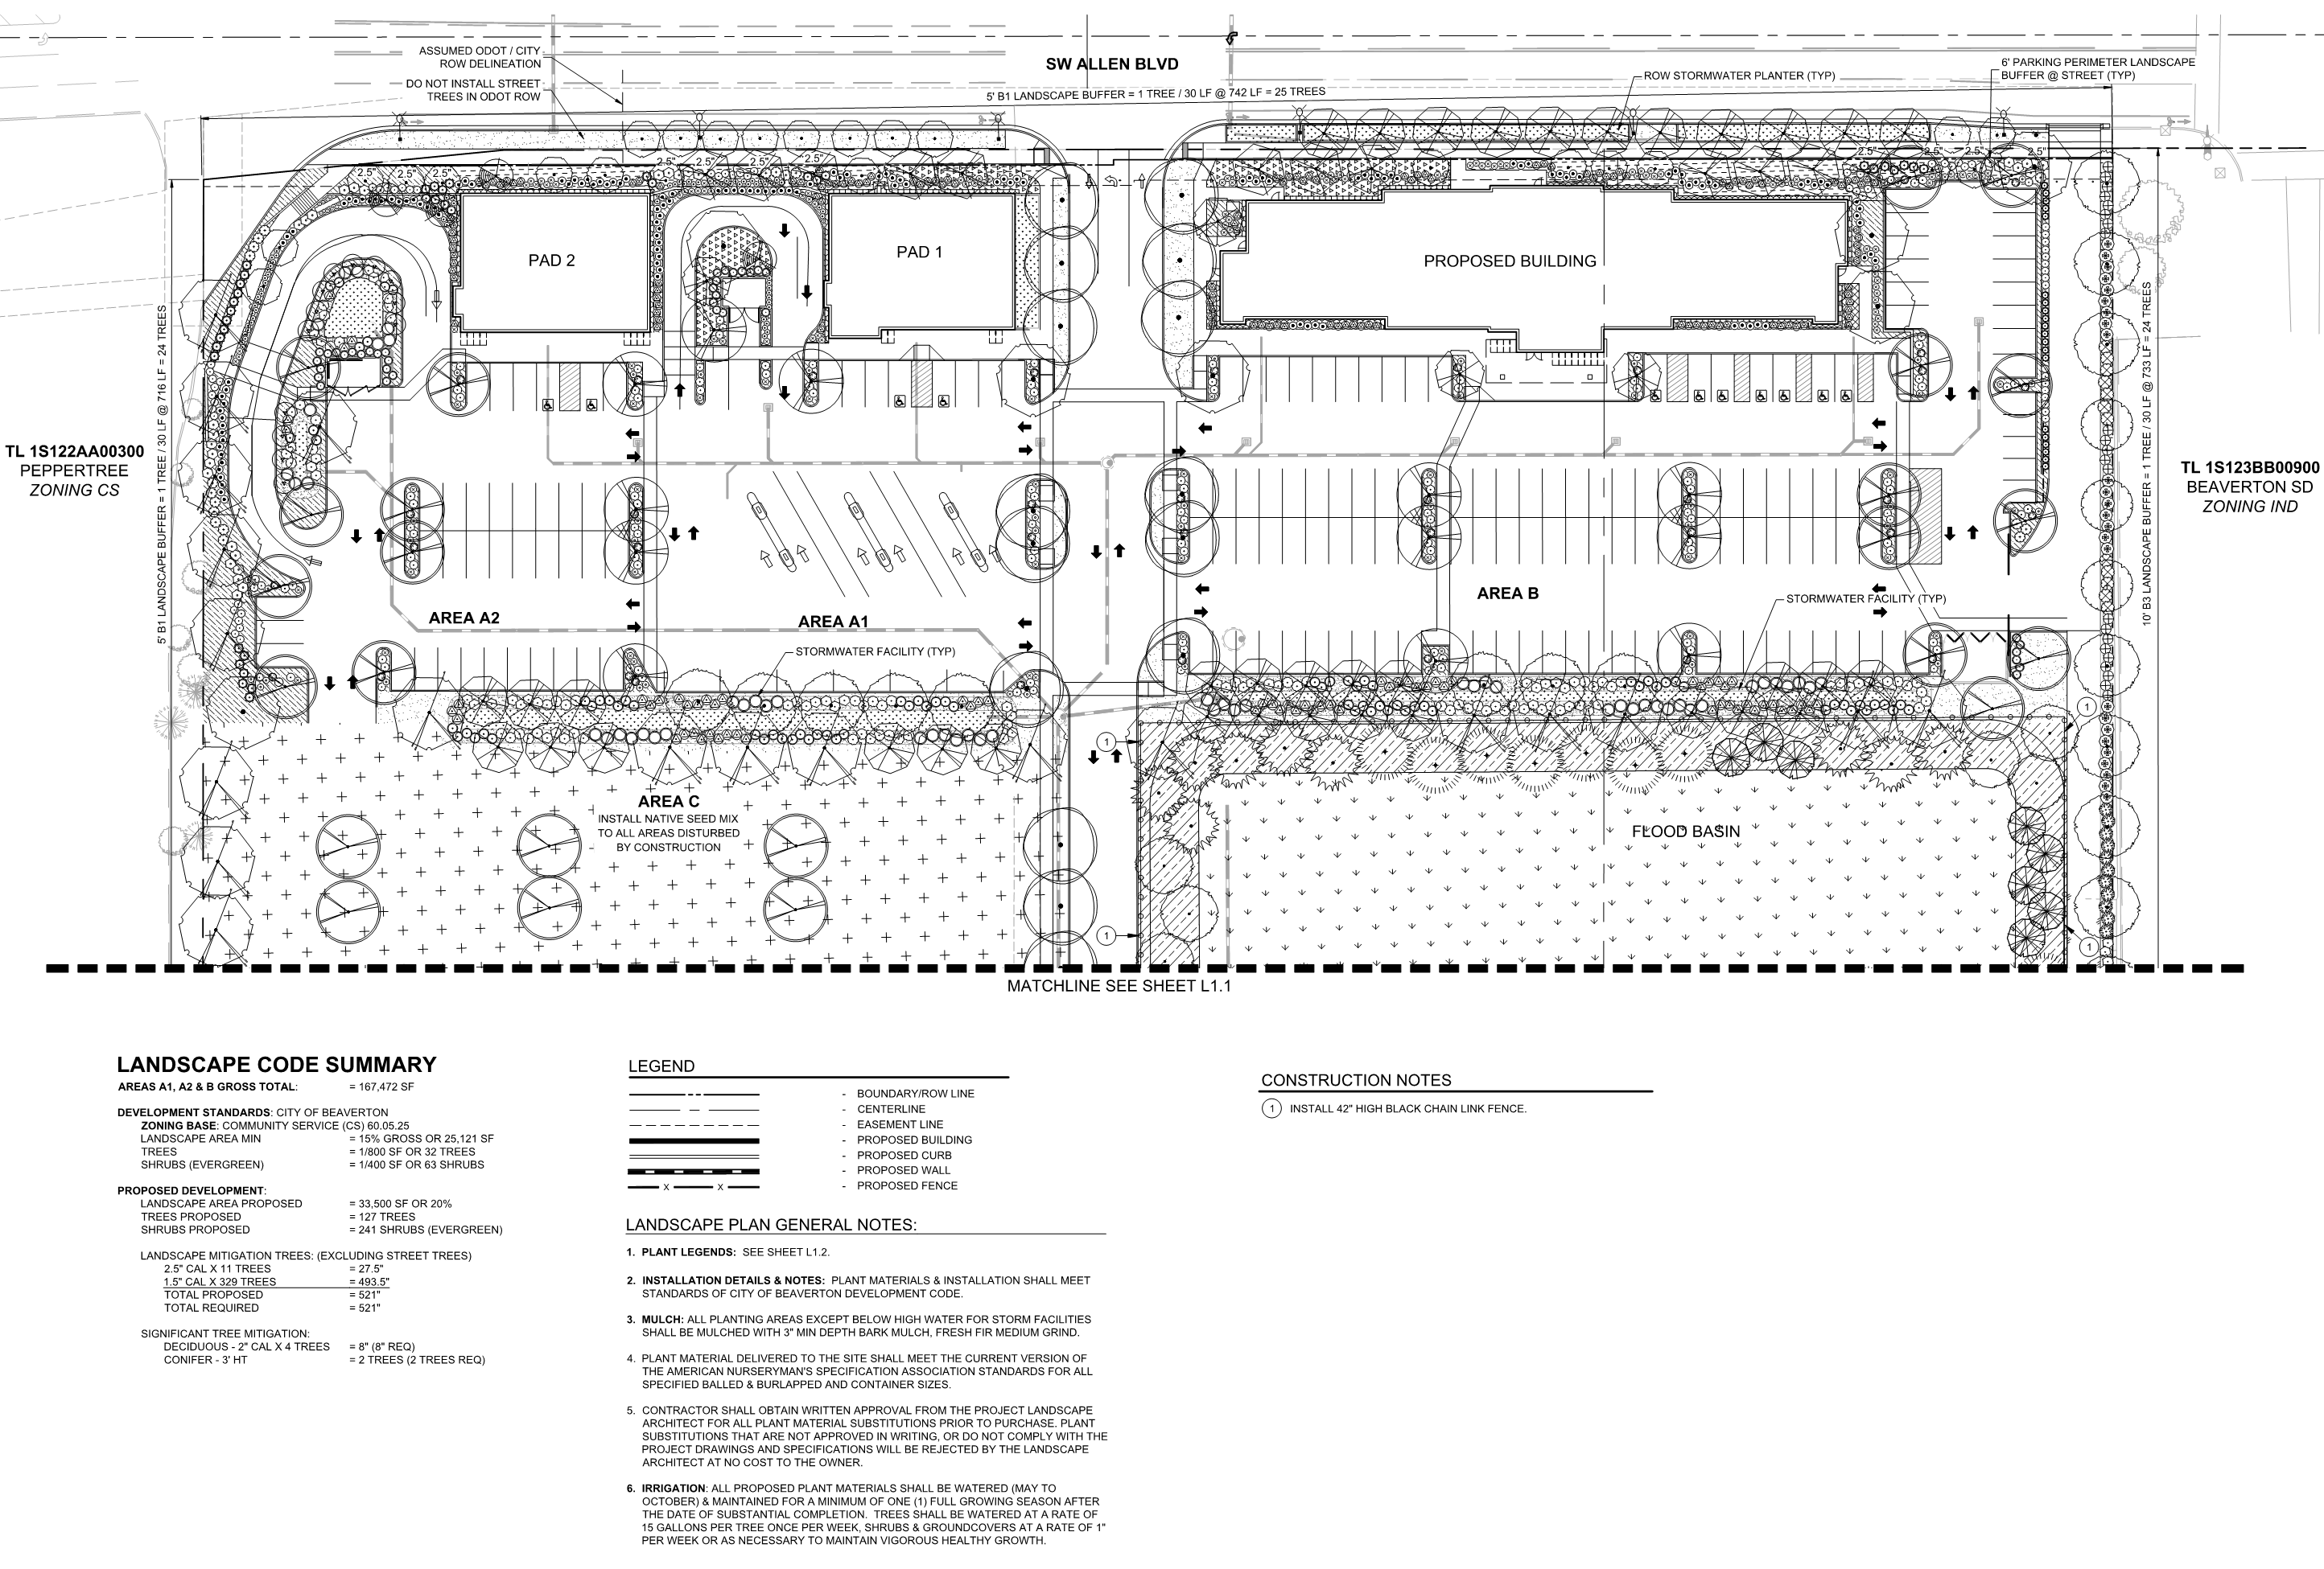

Slide 20
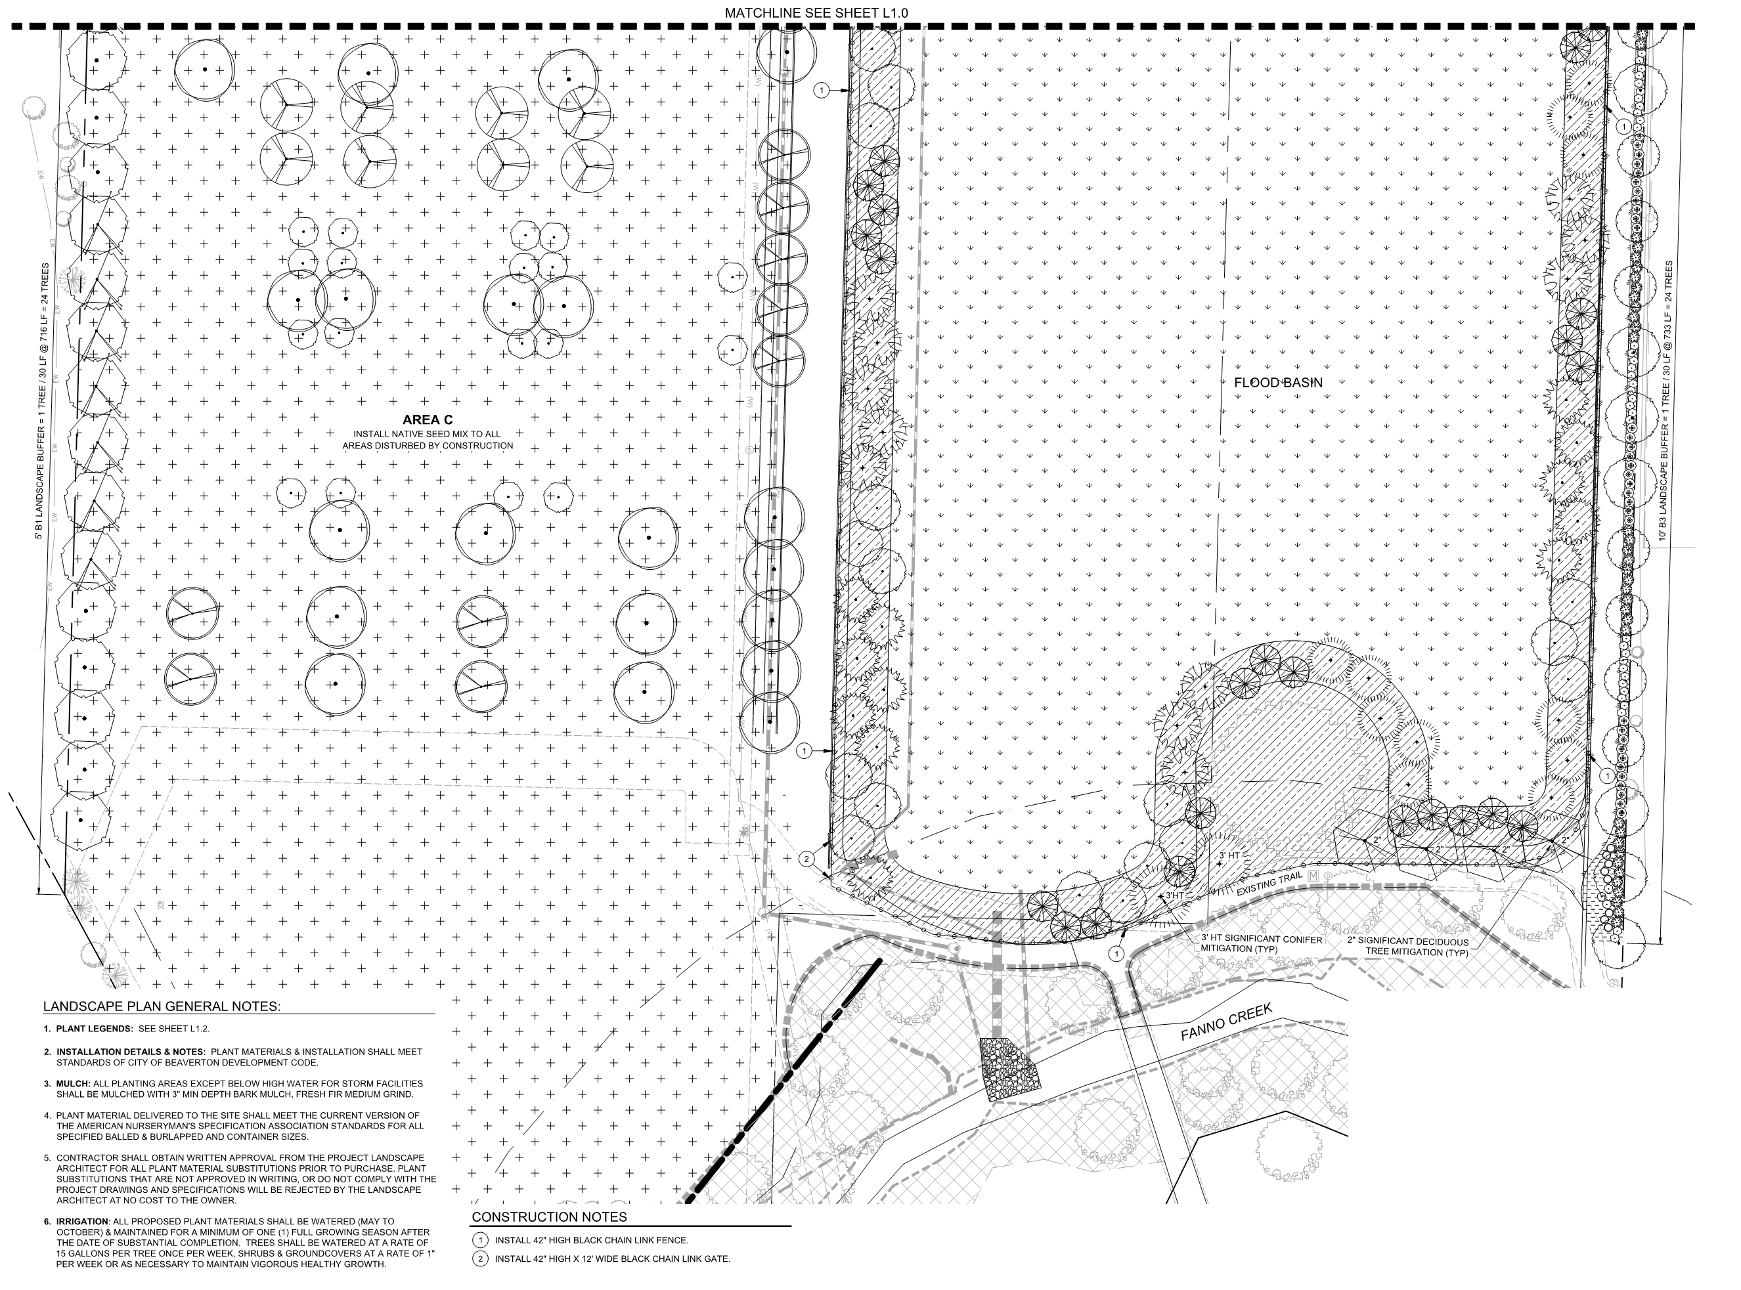

Slide 21
